Slide 1
Measurement
Class 3
EDUC 157: Educational Research and Evaluation
UCI School of Education

Slide 2


Slide 3
Zones and their schools are assigned to the “Catch Up” program
Inputs
If the impact evaluation reveals a positive impact:
You have learned that assignment to the program changed the final outcome(s).
How do you know what drove the effect? How do you know whether all implicit hypotheses were correct?
If the impact evaluation reveals no impact:
You have learned that assignment to the program did not change the final outcome(s).
Where did the Theory of Change break down? Did the program even happen? How do you know how to improve the program?
?
Foundational numeracy
Foundational literacy
Data
Final outcomes

Slide 4
Inputs and activities
Zones and their schools are assigned to the “Catch Up” program
?
Implementation fidelity (e.g., training events held by NGO)
Outputs
?
Program take-up (e.g., remedial classes taught by teachers)
Outputs
?
?
Intermediate Outcomes
Instructional time
Instructional quality
?
?
Children’s foundational numeracy skills
Children’s foundational literacy skills
Final outcomes

Slide 5
Inputs and activities
Zones and their schools are assigned to the “Catch Up” program
Data
?
Implementation fidelity (e.g., training events held by NGO)
Data
Outputs
?
Program take-up (e.g., remedial classes taught by teachers)
Data
Outputs
?
?
Intermediate Outcomes
Instructional time
Instructional quality
Data
?
?
Children’s foundational numeracy skills
Children’s foundational literacy skills
Data
Final outcomes

Slide 6
Plan for today
Measurement concepts
Data sources
Example blueprint

Slide 7
Measurement concepts

Slide 8
Construct
The main concept under empirical investigation. A concept is usually abstract and requires “conceptualization.” Once better defined, more specific, and measurable, we call it a “construct.”
(E.g., foundational literacy).
Theory
Indicators
An observable signal used to measure constructs.
(E.g., whether a child can read a word, whether a child can read a short sentence such as “this is a dog”).
Instrument
The tools we use to measure indicators (e.g., classroom observations, teacher interviews, or student assessments).
Data collection
Data
The numeric values of indicators (“variables”) for the person or group of people we interview, test, or observe (“respondents”, “subjects”).

Slide 9

Notes:
Poll Title: Do not modify the notes in this section to avoid tampering with the Poll Everywhere activity. More info at polleverywhere.com/support Join instructions https://www.polleverywhere.com/join_instructions

Slide 10
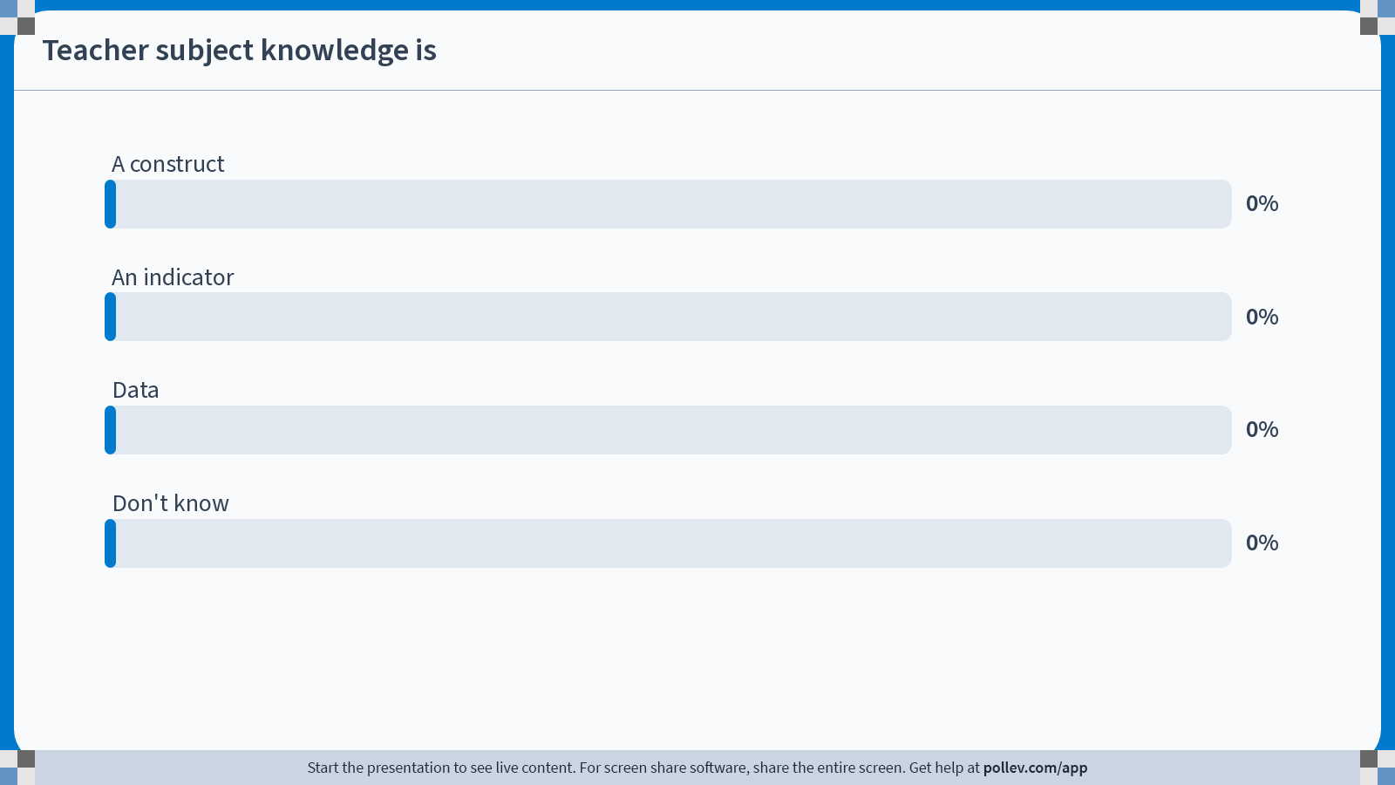
Notes:
Poll Title: Do not modify the notes in this section to avoid tampering with the Poll Everywhere activity. More info at polleverywhere.com/support Teacher subject knowledge is https://www.polleverywhere.com/multiple_choice_polls/fpPKtdyx9VgqkrIuL9782

Slide 11
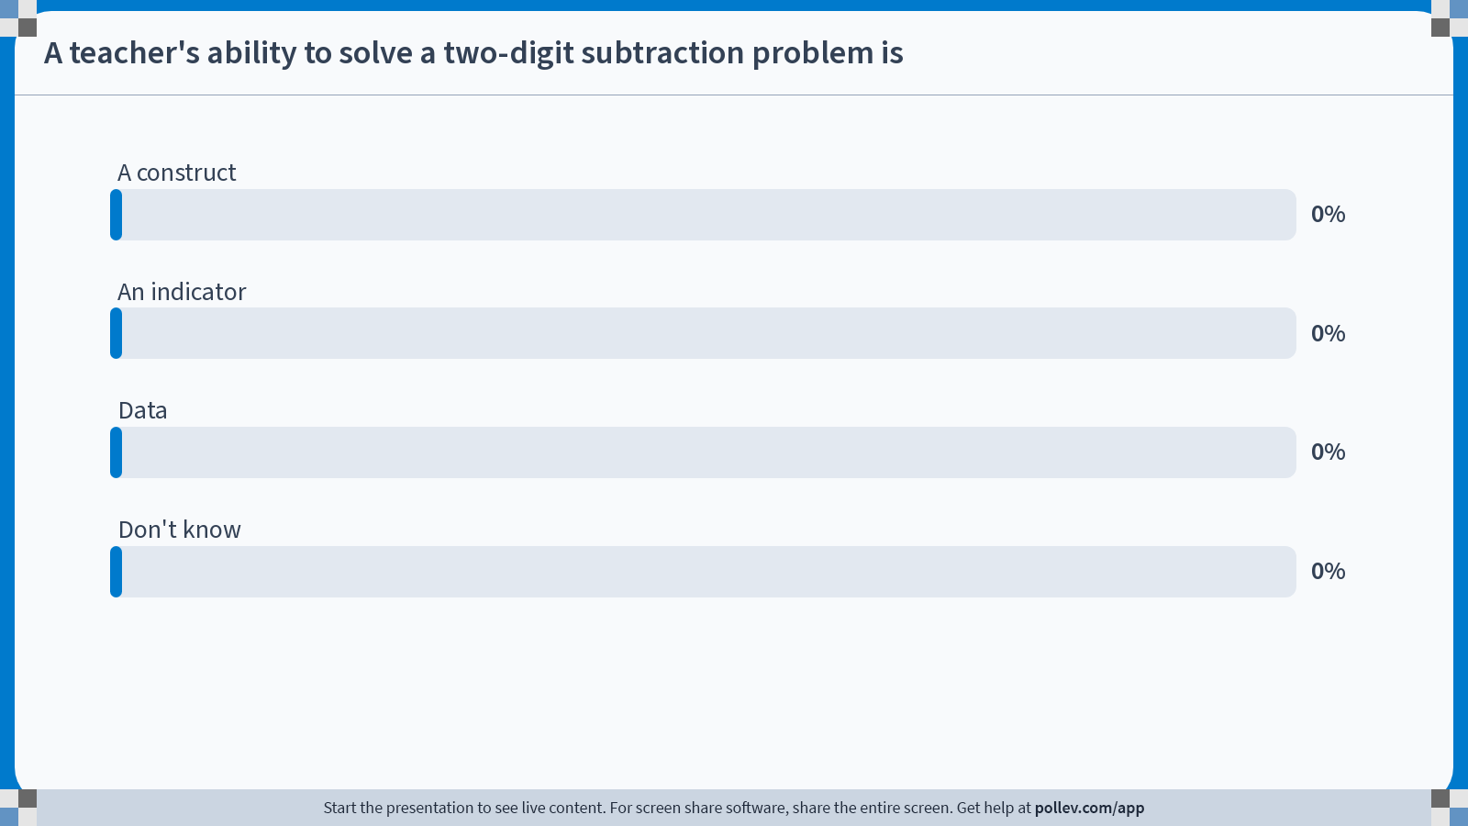
Notes:
Poll Title: Do not modify the notes in this section to avoid tampering with the Poll Everywhere activity. More info at polleverywhere.com/support A teacher's ability to solve a two-digit subtraction problem is https://www.polleverywhere.com/multiple_choice_polls/50NtwLwKDEblFyjBNisAl

Slide 12
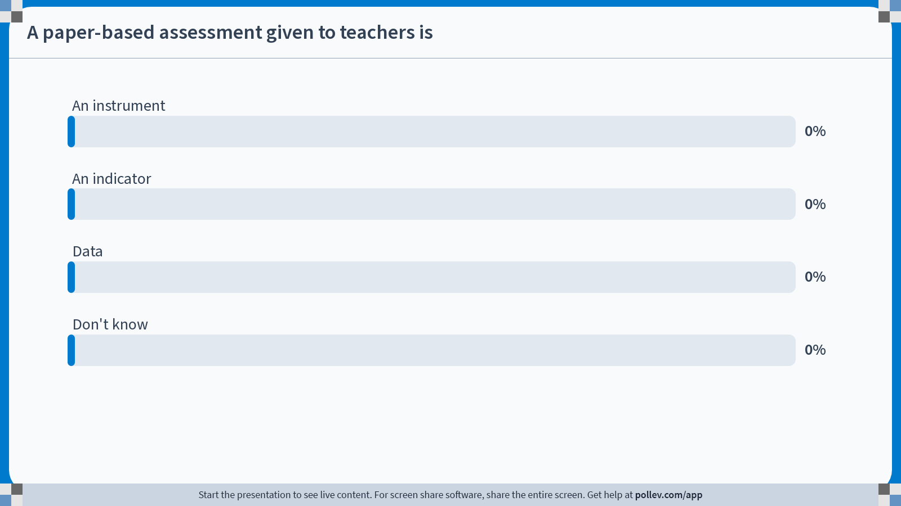
Notes:
Poll Title: Do not modify the notes in this section to avoid tampering with the Poll Everywhere activity. More info at polleverywhere.com/support A paper-based assessment given to teachers is https://www.polleverywhere.com/multiple_choice_polls/yCF3rhIU8RwpdwxmkA8Aa

Slide 13
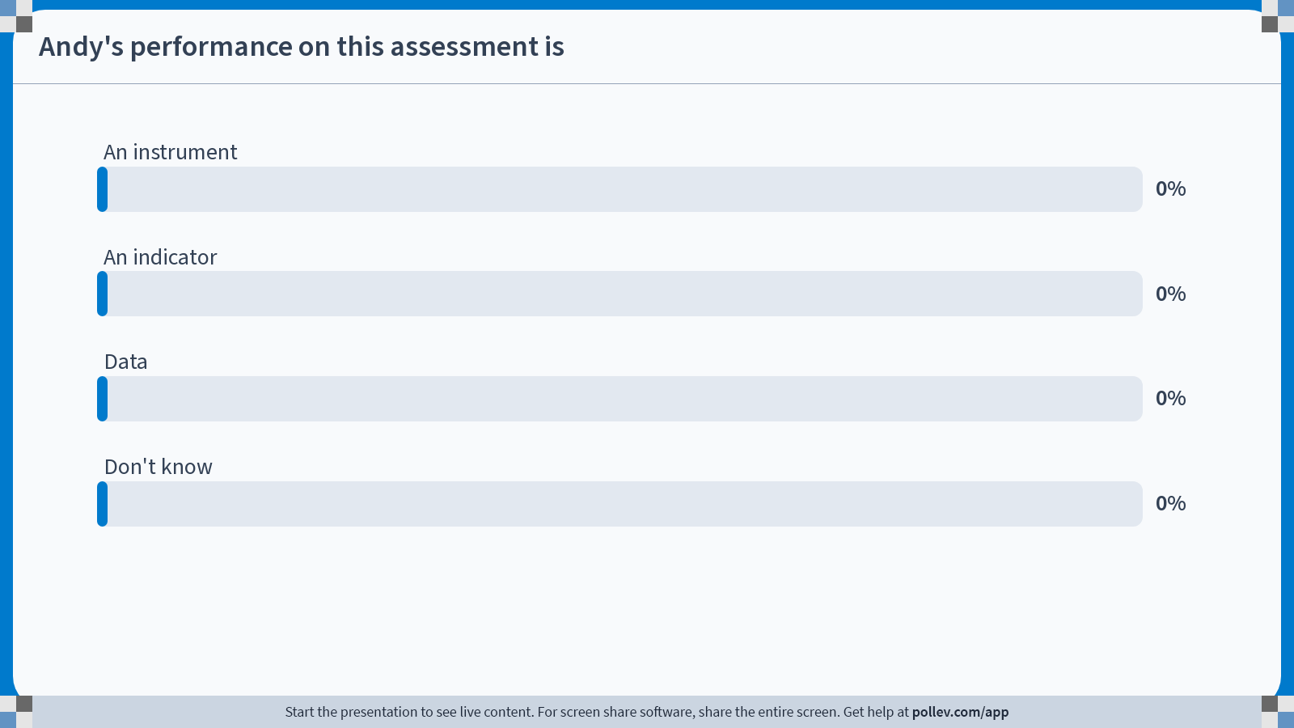
Notes:
Poll Title: Do not modify the notes in this section to avoid tampering with the Poll Everywhere activity. More info at polleverywhere.com/support Andy's performance on this assessment is https://www.polleverywhere.com/multiple_choice_polls/O0ZjW9hGJdSHbgxcPSt4Y

Slide 14
Teacher subject knowledge is
A construct
An indicator
Data
Don’t know
Notes:
A Construct – Child school preformance is a construct that can be measured in various ways

Slide 15
A teacher’s ability to solve a two-digit subtraction problem is
A construct
An indicator
Data
Don’t know
Notes:
An indicator.

Slide 16
A paper-based assessment given to teachers is
An instrument
An indicator
Data
Don’t know
Notes:
Answer: Data.

Slide 17
Andy’s performance on this assessment is
An instrument
An indicator
Data
Don’t know
Notes:
Answer: Data.

Slide 18
Which indicators?
Teacher subject knowledge
Two-digit subtraction
Procedures
Pedagogical knowledge
Real analysis
Problem-solving
Knowledge of student learning
Knowledge of curriculum
Etc.

Slide 19
Which instruments?
Teacher subject knowledge
Teacher interview
Assessment
Classroom observation
Peer report
Student evaluations
Portfolio
Etc.

Slide 20
Measurement criteria
Validity
Low
High
Reliability
Low
High

Slide 21
Validity (a.k.a. accuracy, unbiasedness)
Construct
How well does the indicator map to the construct we are trying to measure?
Theory
Indicators, instruments
low
high
Can we collect data on the indicator in an unbiased way?
Data collection
Data

Slide 22
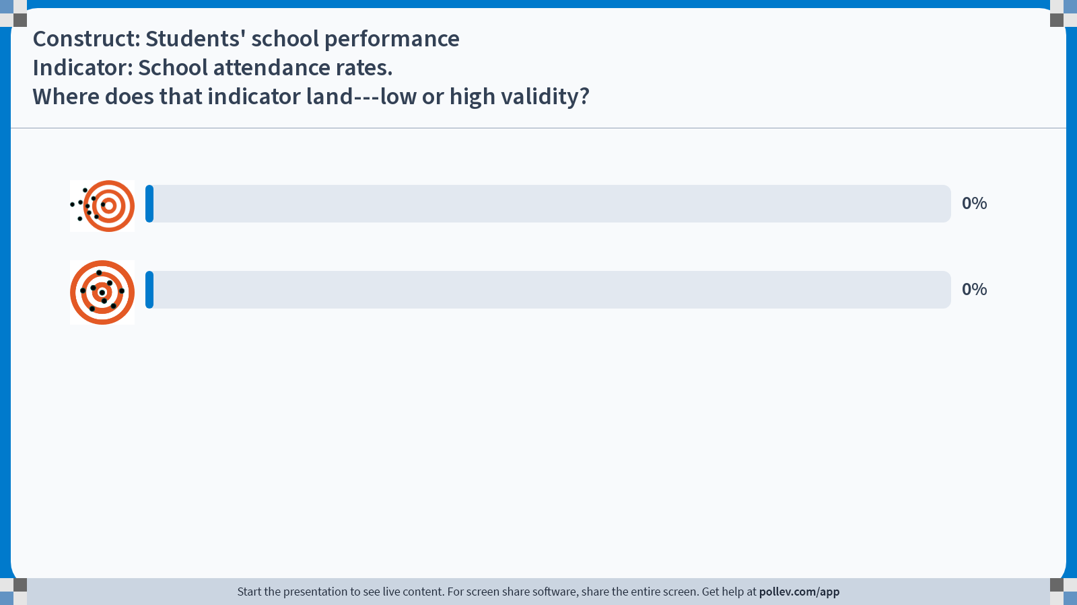
Notes:
Poll Title: Do not modify the notes in this section to avoid tampering with the Poll Everywhere activity. More info at polleverywhere.com/support Construct: Students' school performanceIndicator: School attendance rates.Where does that indicator land---low or high validity? https://www.polleverywhere.com/multiple_choice_polls/49mDyy2ghvazhuCpUDpJi?state=opened&flow=Default&onscreen=persist

Slide 23
Question:
Construct: Students’ school performance
Indicator: School attendance rates
Where does that indicator land?
Validity (a.k.a. accuracy/unbiased)
Low
High
A
B

Slide 24
Reliability (a.k.a. precision, signal-vs.-noise)
Construct
How time/situation specific is the indicator?
Theory
Low
Indicators, instruments
Is the indicator measured in a way that is consistent and precise? Would we get the same data if we measured several times?
Data collection
Data
High

Slide 25
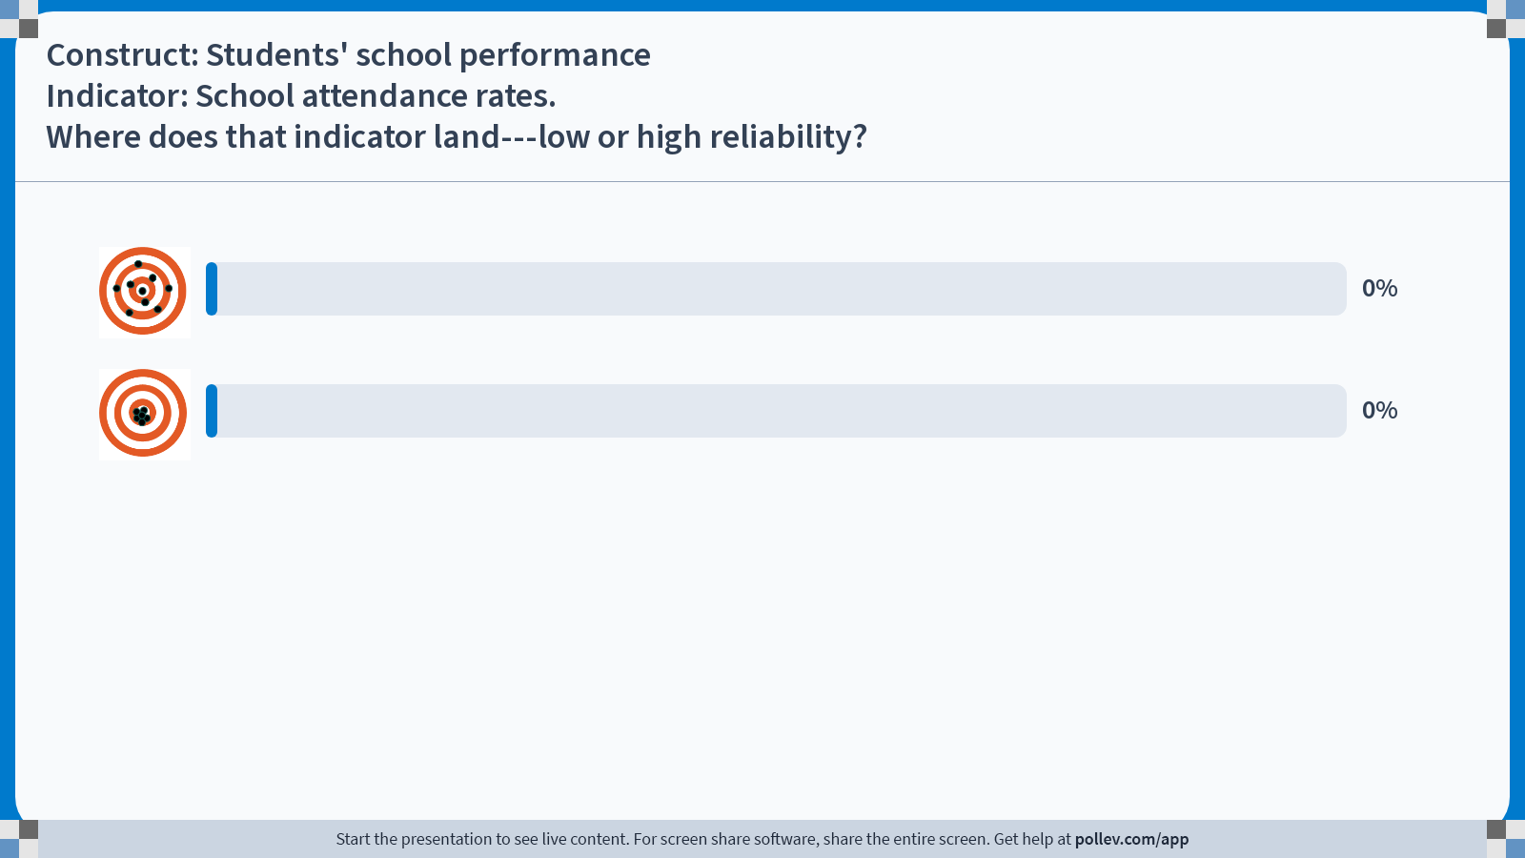
Notes:
Poll Title: Do not modify the notes in this section to avoid tampering with the Poll Everywhere activity. More info at polleverywhere.com/support Construct: Students' school performanceIndicator: School attendance rates.Where does that indicator land---low or high reliability? https://www.polleverywhere.com/multiple_choice_polls/9eLdcm6q4jv0eviBCLF7x?state=opened&flow=Default&onscreen=persist

Slide 26
Question:
Construct: Students’ school performance
Indicator: School attendance rates
Where does that indicator land?
Reliability
(a.k.a. precision)
A
low
B
high

Slide 27
Validity
Low
High
Low
Reliability
High

Slide 28
Maximizing validity
Theory: Think about how the indicator maps to the construct
Practice: Make sure data is collected in a way that is not systematically biased
Possible sources of bias
Theory/mapping Experimenter demand effects Social desirability bias Recall bias Translation/interpretation
Possible ways to minimize bias
Use admin. data where possible Use methods for sensitive topics Back translation and piloting Use multiple data sources

Slide 29
Maximizing reliability
Theory: Think about how the indicator maps to the construct
Practice: Make sure data is collected in a way that is not systematically biased
Possible sources of noise
Fatigue Ambiguous wording (e.g., “# people in household”) Think about how time/situation-specific the indicator is
Possible ways to maximize reliability
Consider survey length Consider the answer choices Piloting Training of survey staff Conduct data quality checks Use validated indicators from the same context

Slide 30
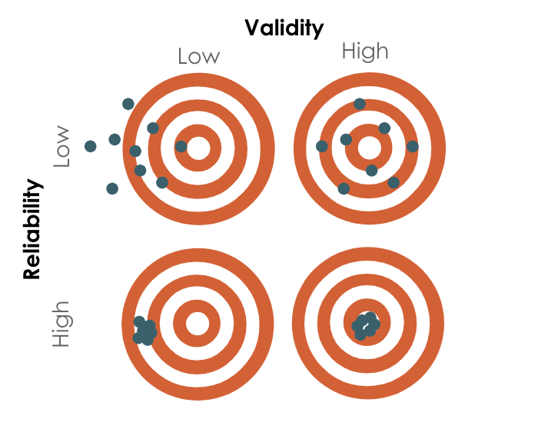
Question:
Which is the worst?
Low validity, low reliability
Low validity, high reliability
High validity, low reliability
All equally bad
Don’t know/can’t say

Slide 31
SMART
Specific
To measure the information required as closely as possible
Measurable
To ensure that the information can be readily obtained
Attributable
To ensure that each measure is linked to the project’s efforts
Realistic
To ensure that the data can be obtained in a timely fashion, with
reasonable frequency, and at reasonable cost
Targeted
To the objective population

Slide 32
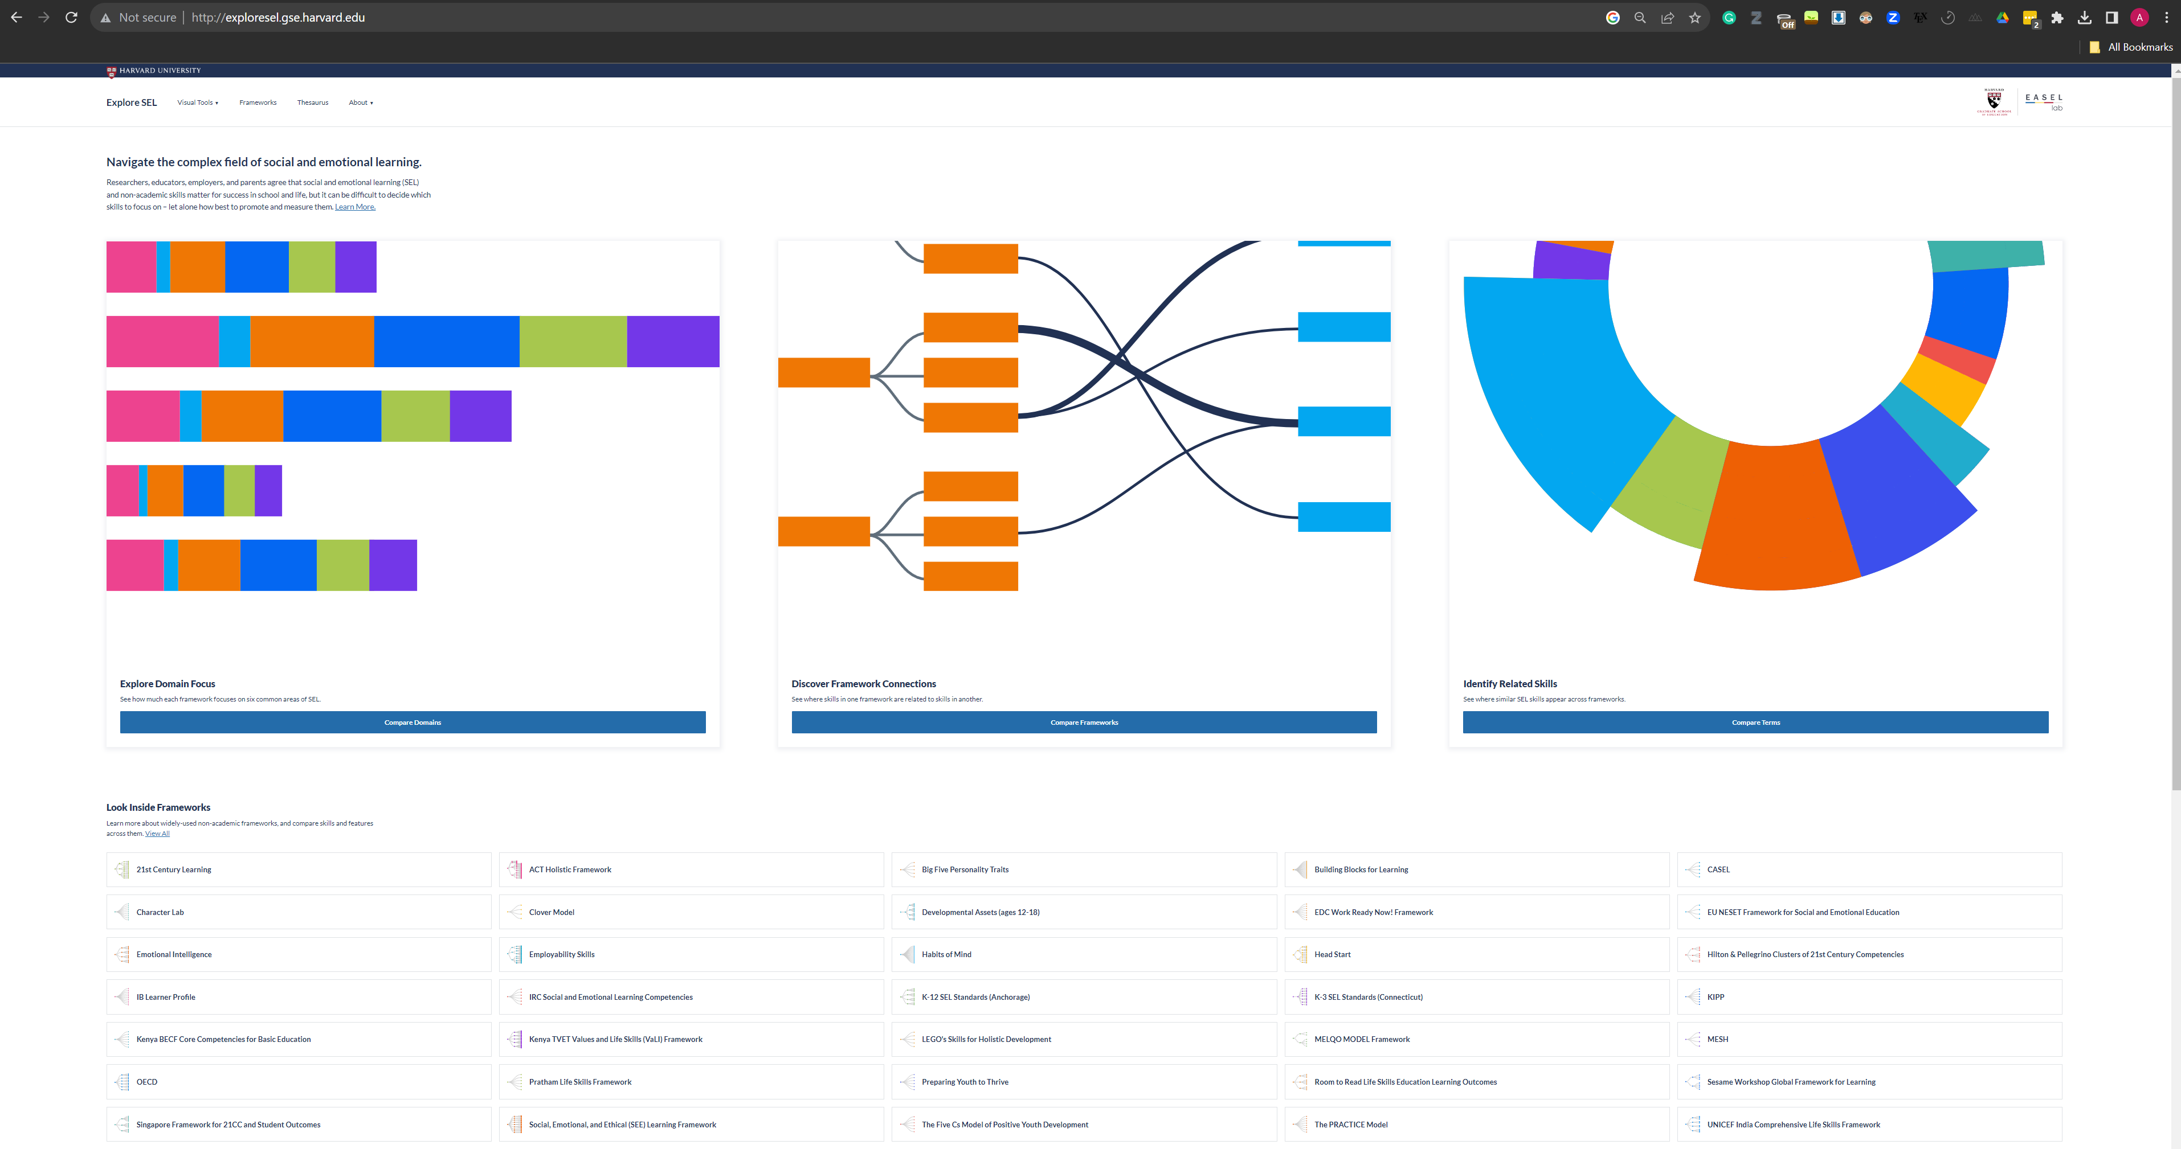

Slide 33
Data sources

Slide 34
Primary data
Secondary data
Surveys
Admin. data
Focus groups
Sensor data
Observations
Web traffic, click-stream, phone
Games
Existing research data
Diaries
Maps
Assessments
Text, audio, video

Slide 35
The promise of secondary data
Data quality
Objective (?)
Representative
Covers pre-policy / pre-program periods, and is robust to attrition
Sample size
More treatment arms possible
More precise—but not more causal—estimates
Higher speed and lower cost
Provides a ready sampling frame for surveys, replacing need for a full census/listing
May replace costly field data collection
Innovative uses
Descriptive statistics for pilots and policy analysis
Hybrid studies combining administrative with survey data
Completely new data and unique measurement tools
Machine learning / AI tools overlaid on admin data

Slide 36
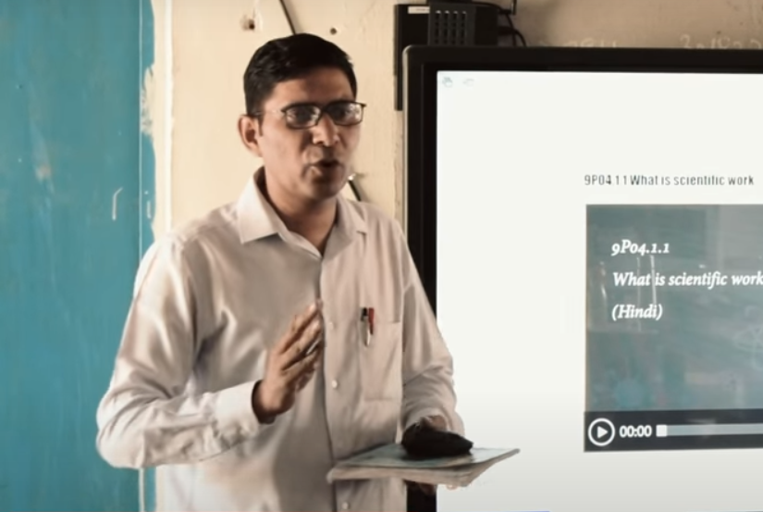
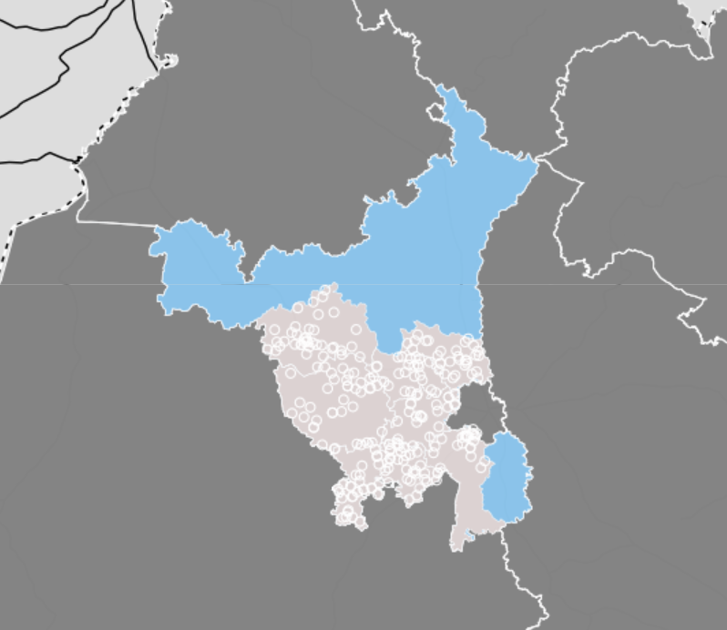

Slide 37
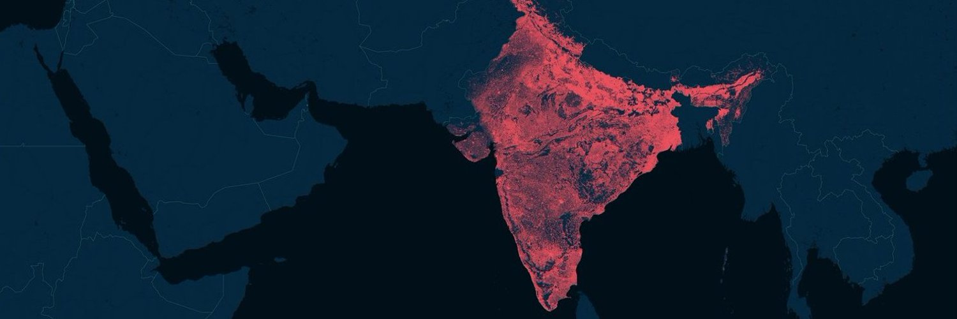

Slide 38
Example
blueprint

Slide 39
What are the data collection rounds?
Jul-Oct 2022
Independent baseline data collection
Jun/Jul 2023 Independent "Process monitoring” round 1
Oct/Nov 2024
Independent endline data collection
Jan 2023
Roll-out of CU and CPD in schools
Jun/Jul 2024
Independent "Process monitoring” round 2
~2 years of program implementation between baseline and endline.
VVOB will collect additional, administrative data on program costs and implementation activities.

Slide 40
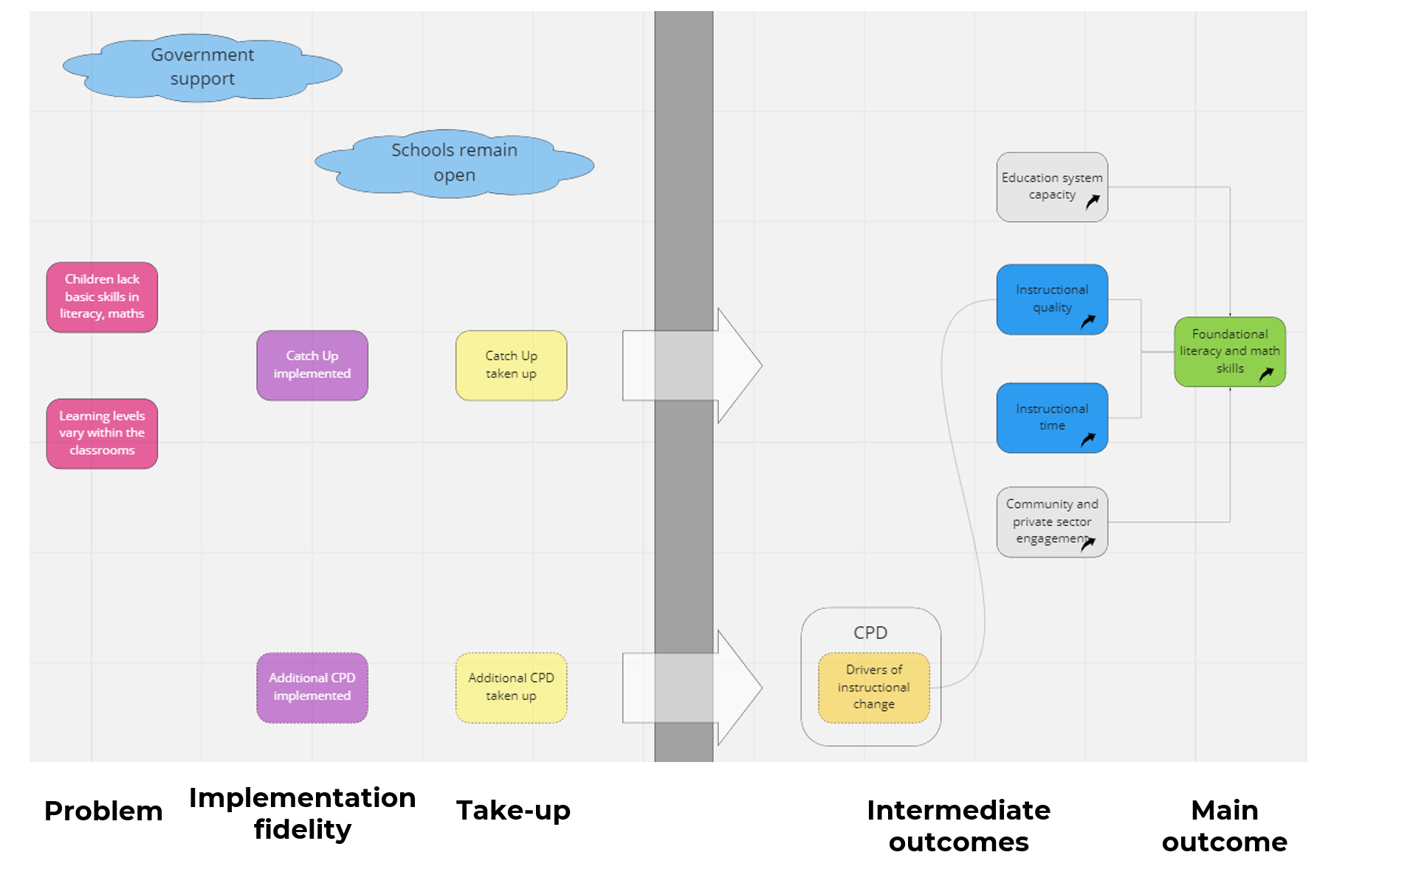
Alignment with Catch Up’s Theory of Change

Slide 41
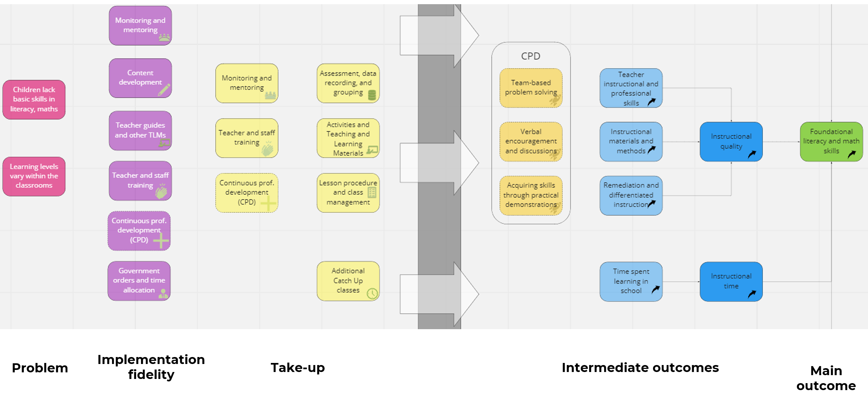
Alignment with Catch Up’s Theory of Change

Slide 42
Data collection blueprint
Round | Source | Concept | Ex. indicators | Theory | Analyses
Listing exercise. | Phone calls to headmasters. | School list and student enrollment. | No. of students enrolled in grade 3 at baseline. | Schools exist, enroll students in grades 3-5. | Confirming the school sample; descriptive information on schools.
Baseline. | Enrollment rosters; one-on-one student and teacher interviews; student assessments. | Enrollment; student, teacher, school characteristics (incl. student learning levels). | Student’s gender Student’s test score Student’s ASER levels Student’s language Teacher’s language spoken at home | Random sample is representative. Potentially different effects by gender, baseline learning levels are of interest. | Attrition rates to endline. Subgroup analyses at endline. Controls provide additional precision. Additional baseline descriptives as requested.
“Process monitoring” rounds 1 and 2. | One-on-one student and teacher interviews, classroom obs. | Implementation fidelity and program take-up. | Teachers hold Catch Up classes. Teachers participate in CPD. | The program is implemented as intended, teachers use it (Catch Up and CPD). | Descriptives, for the randomly assigned program schools only.
“Process monitoring” rounds 1 and 2. | One-on-one student and teacher interviews, classroom obs. | Intermediate outcomes. | Instructional time. Teaching quality. | Teacher skills improve. Instructional time, quality improves. Remedial instruction increases. | Program impacts, comparing the three experimental arms.
Endline. | One-on-one student and teacher interviews, student assessments. | Main outcomes. | Student’s test score Student’s ASER levels | Foundational learning improves (in math and literacy). | Program impacts, comparing the three experimental arms. Subgroup analyses.
Admin. data. | Training attendance data; CPD backend data; financial records. | Implementation fidelity and program take-up; intervention characteristics. | Staff participate in trainings. Teachers participate in CPD. Costs per child. | The program is implemented as intended, teachers use it (Catch Up and CPD). Costs are of interest. | Descriptives, for the randomly assigned program schools only; cost effectiveness analysis.
Notes:
Process monitoring in quotes, as it also measures intermediate outcomes (it does not just monitor program implementation and take-up.

Slide 43
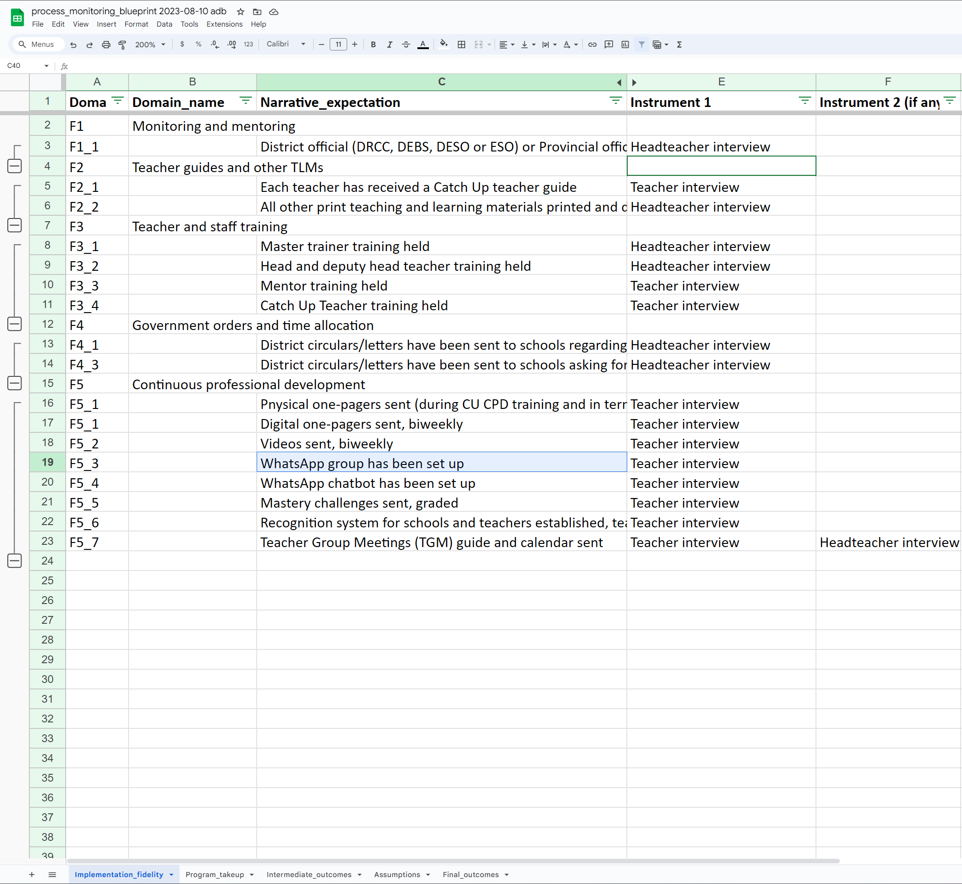
Data collection blueprint
https://docs.google.com/spreadsheets/d/1pgvvRHDp8IC3U_-CIS2ONfBN-EMrJgjnTjI6_HivCIM/edit?usp=sharing
Notes:
Process monitoring in quotes, as it also measures intermediate outcomes (it does not just monitor program implementation and take-up.

Slide 44
Plan for next class
Reading reactions
Submit on Canvas, ask for help on Slack
Submit Milestone 1
Due at the end of the week
Meet with your team
Submit on Canvas

